Slide 1
Airline Safety Executive Summary
DSC640 Nicholas Salisbury
Bellevue University

Slide 2
Income
Events of 9/11 impacted income for several years
The Great Recession in 2008 stunted growth
Covid has caused a major hit in 2020
Major global events impact income, not safety events

Slide 3
Passengers
926 Million
Major impacts to ridership are not caused by safety events.
Global recession and pandemic have caused dips in passengers
926 Million Passengers in 2019!
Covid-19

Slide 4
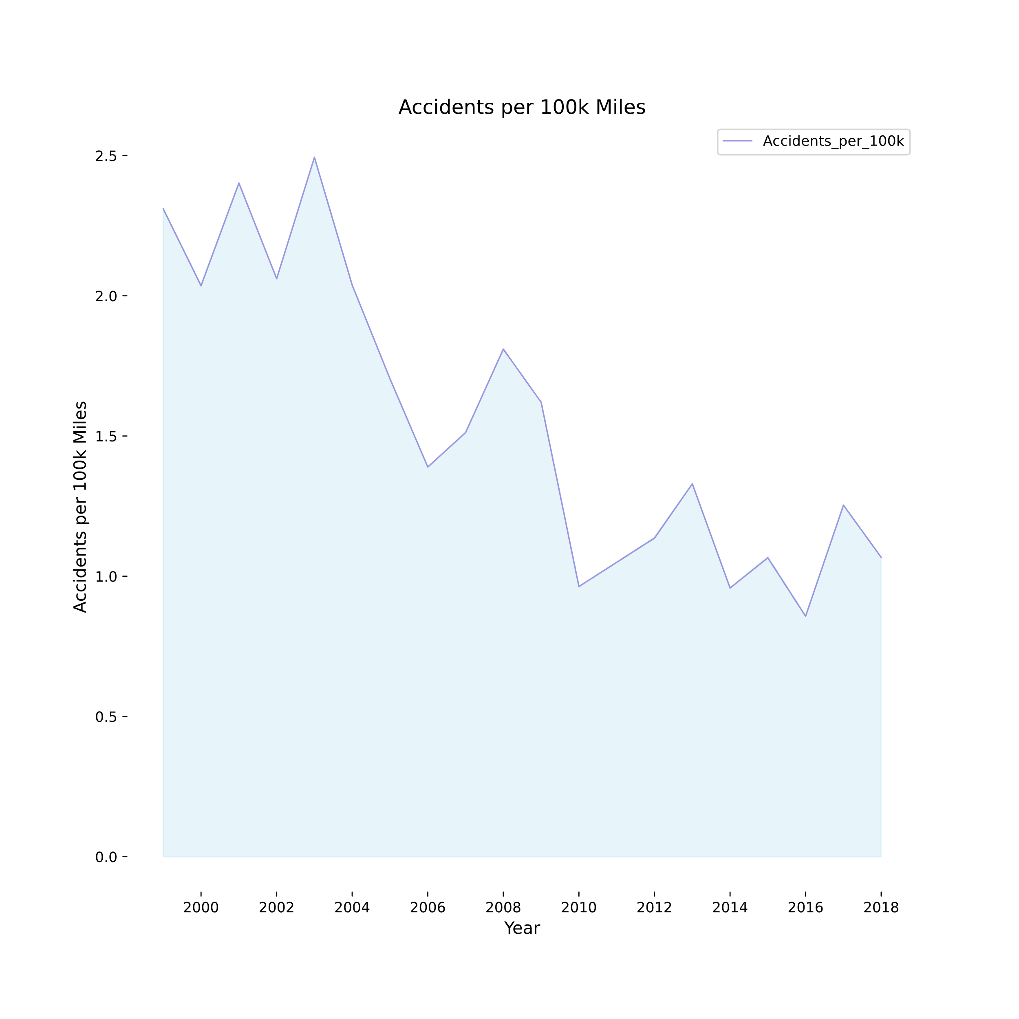
Air Travel is Safe! Less than 1.5 accidents per 100,000 passenger miles for the last 10 years!

Slide 5
What can be improved?
Survivability!
In most years, airplane crashes result in a 50 to 75% fatality rate.

Slide 6
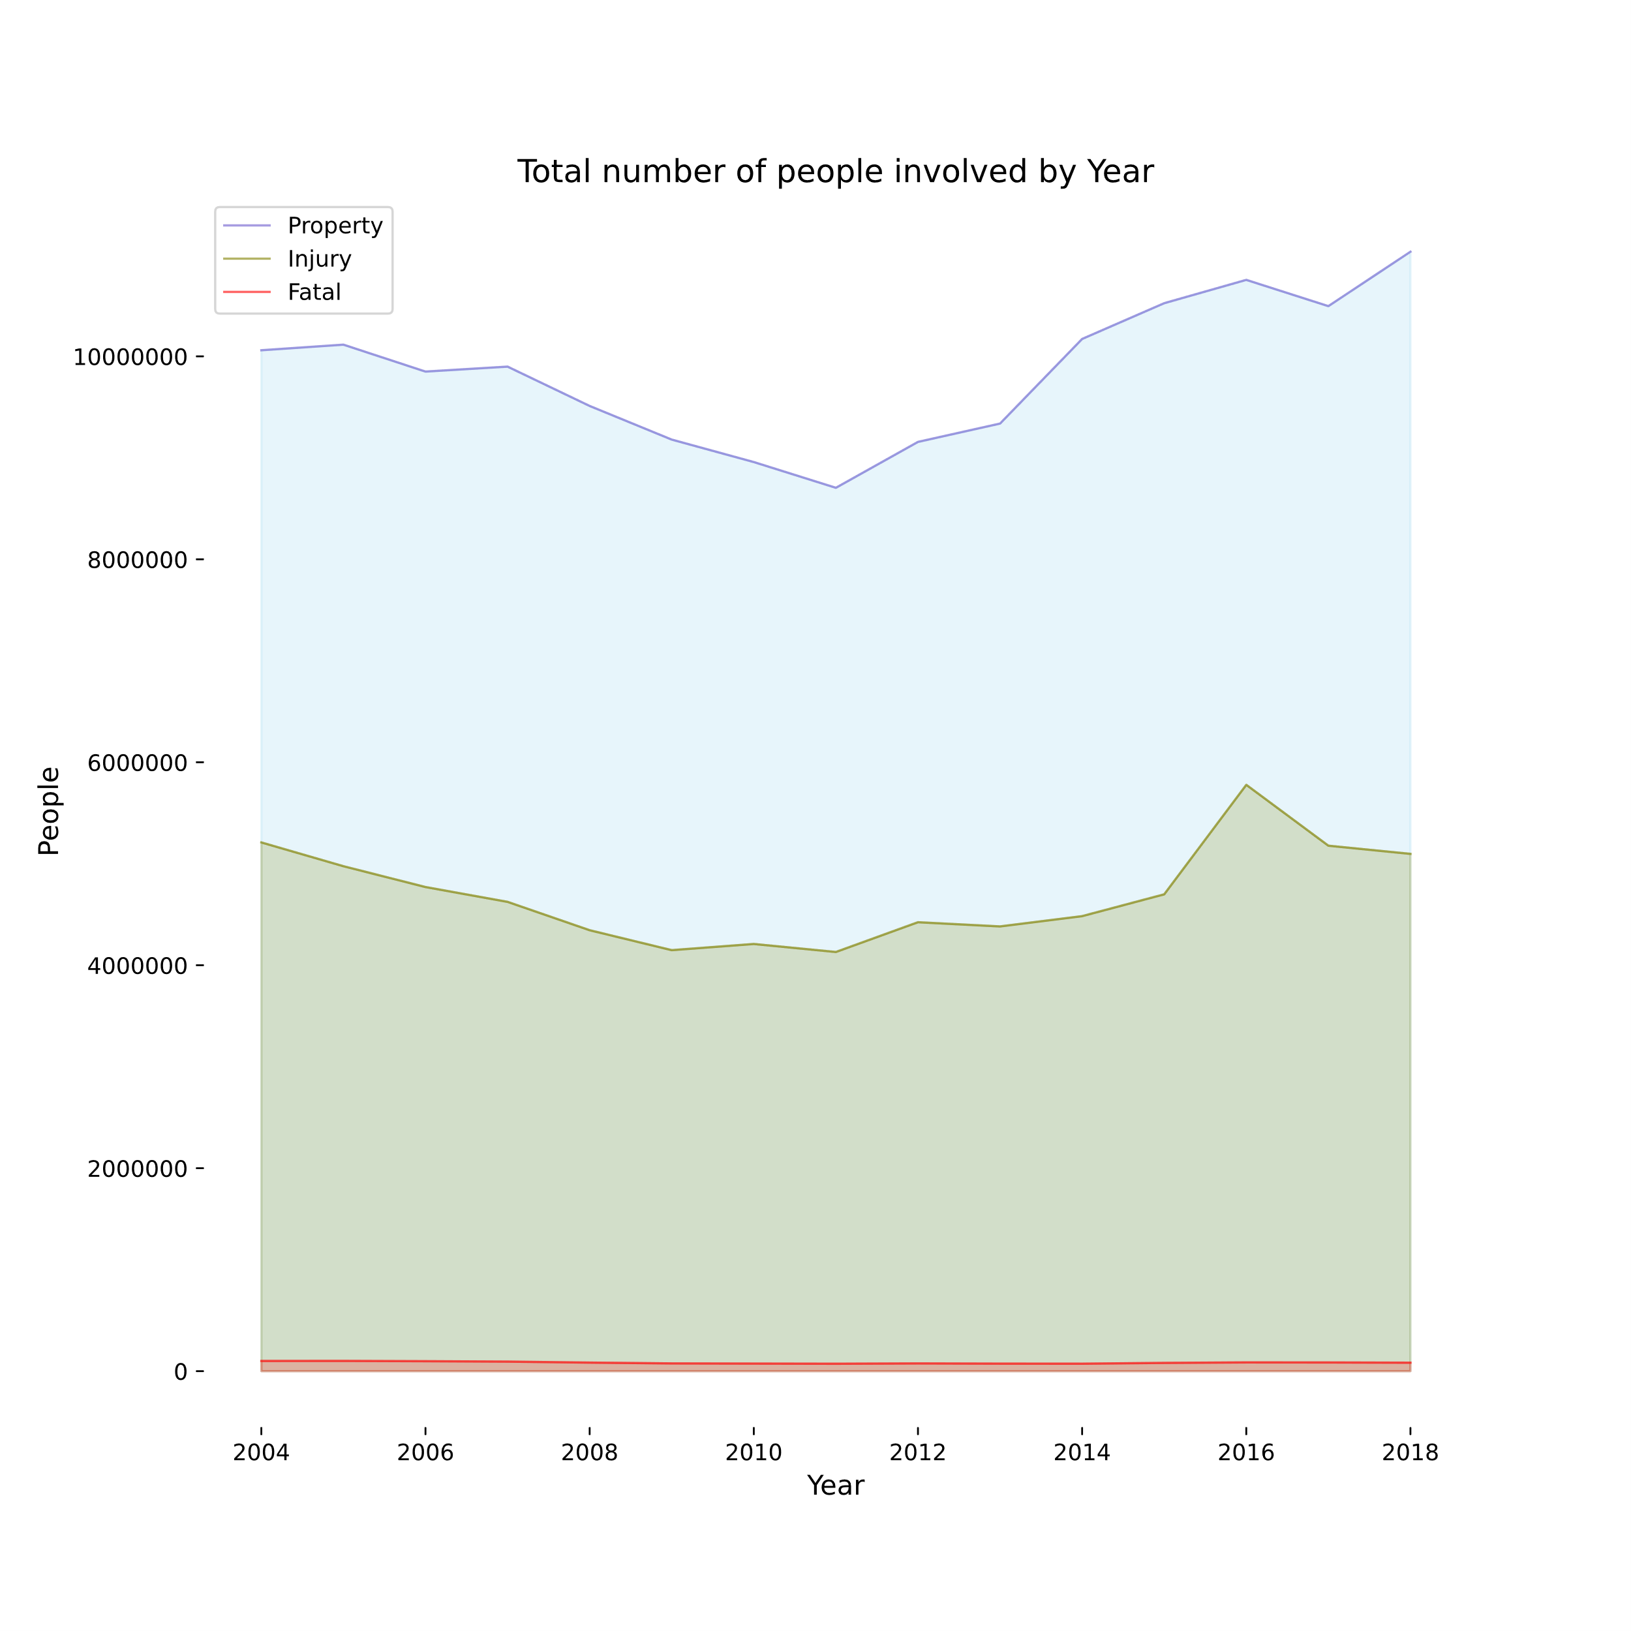
Car Accidents
Over 15 million people involved car accidents in 2018
Over 100,000 people involved in fatal car accidents
But you hear about people having a fear of flying.
But national media covers plane accidents

Slide 7
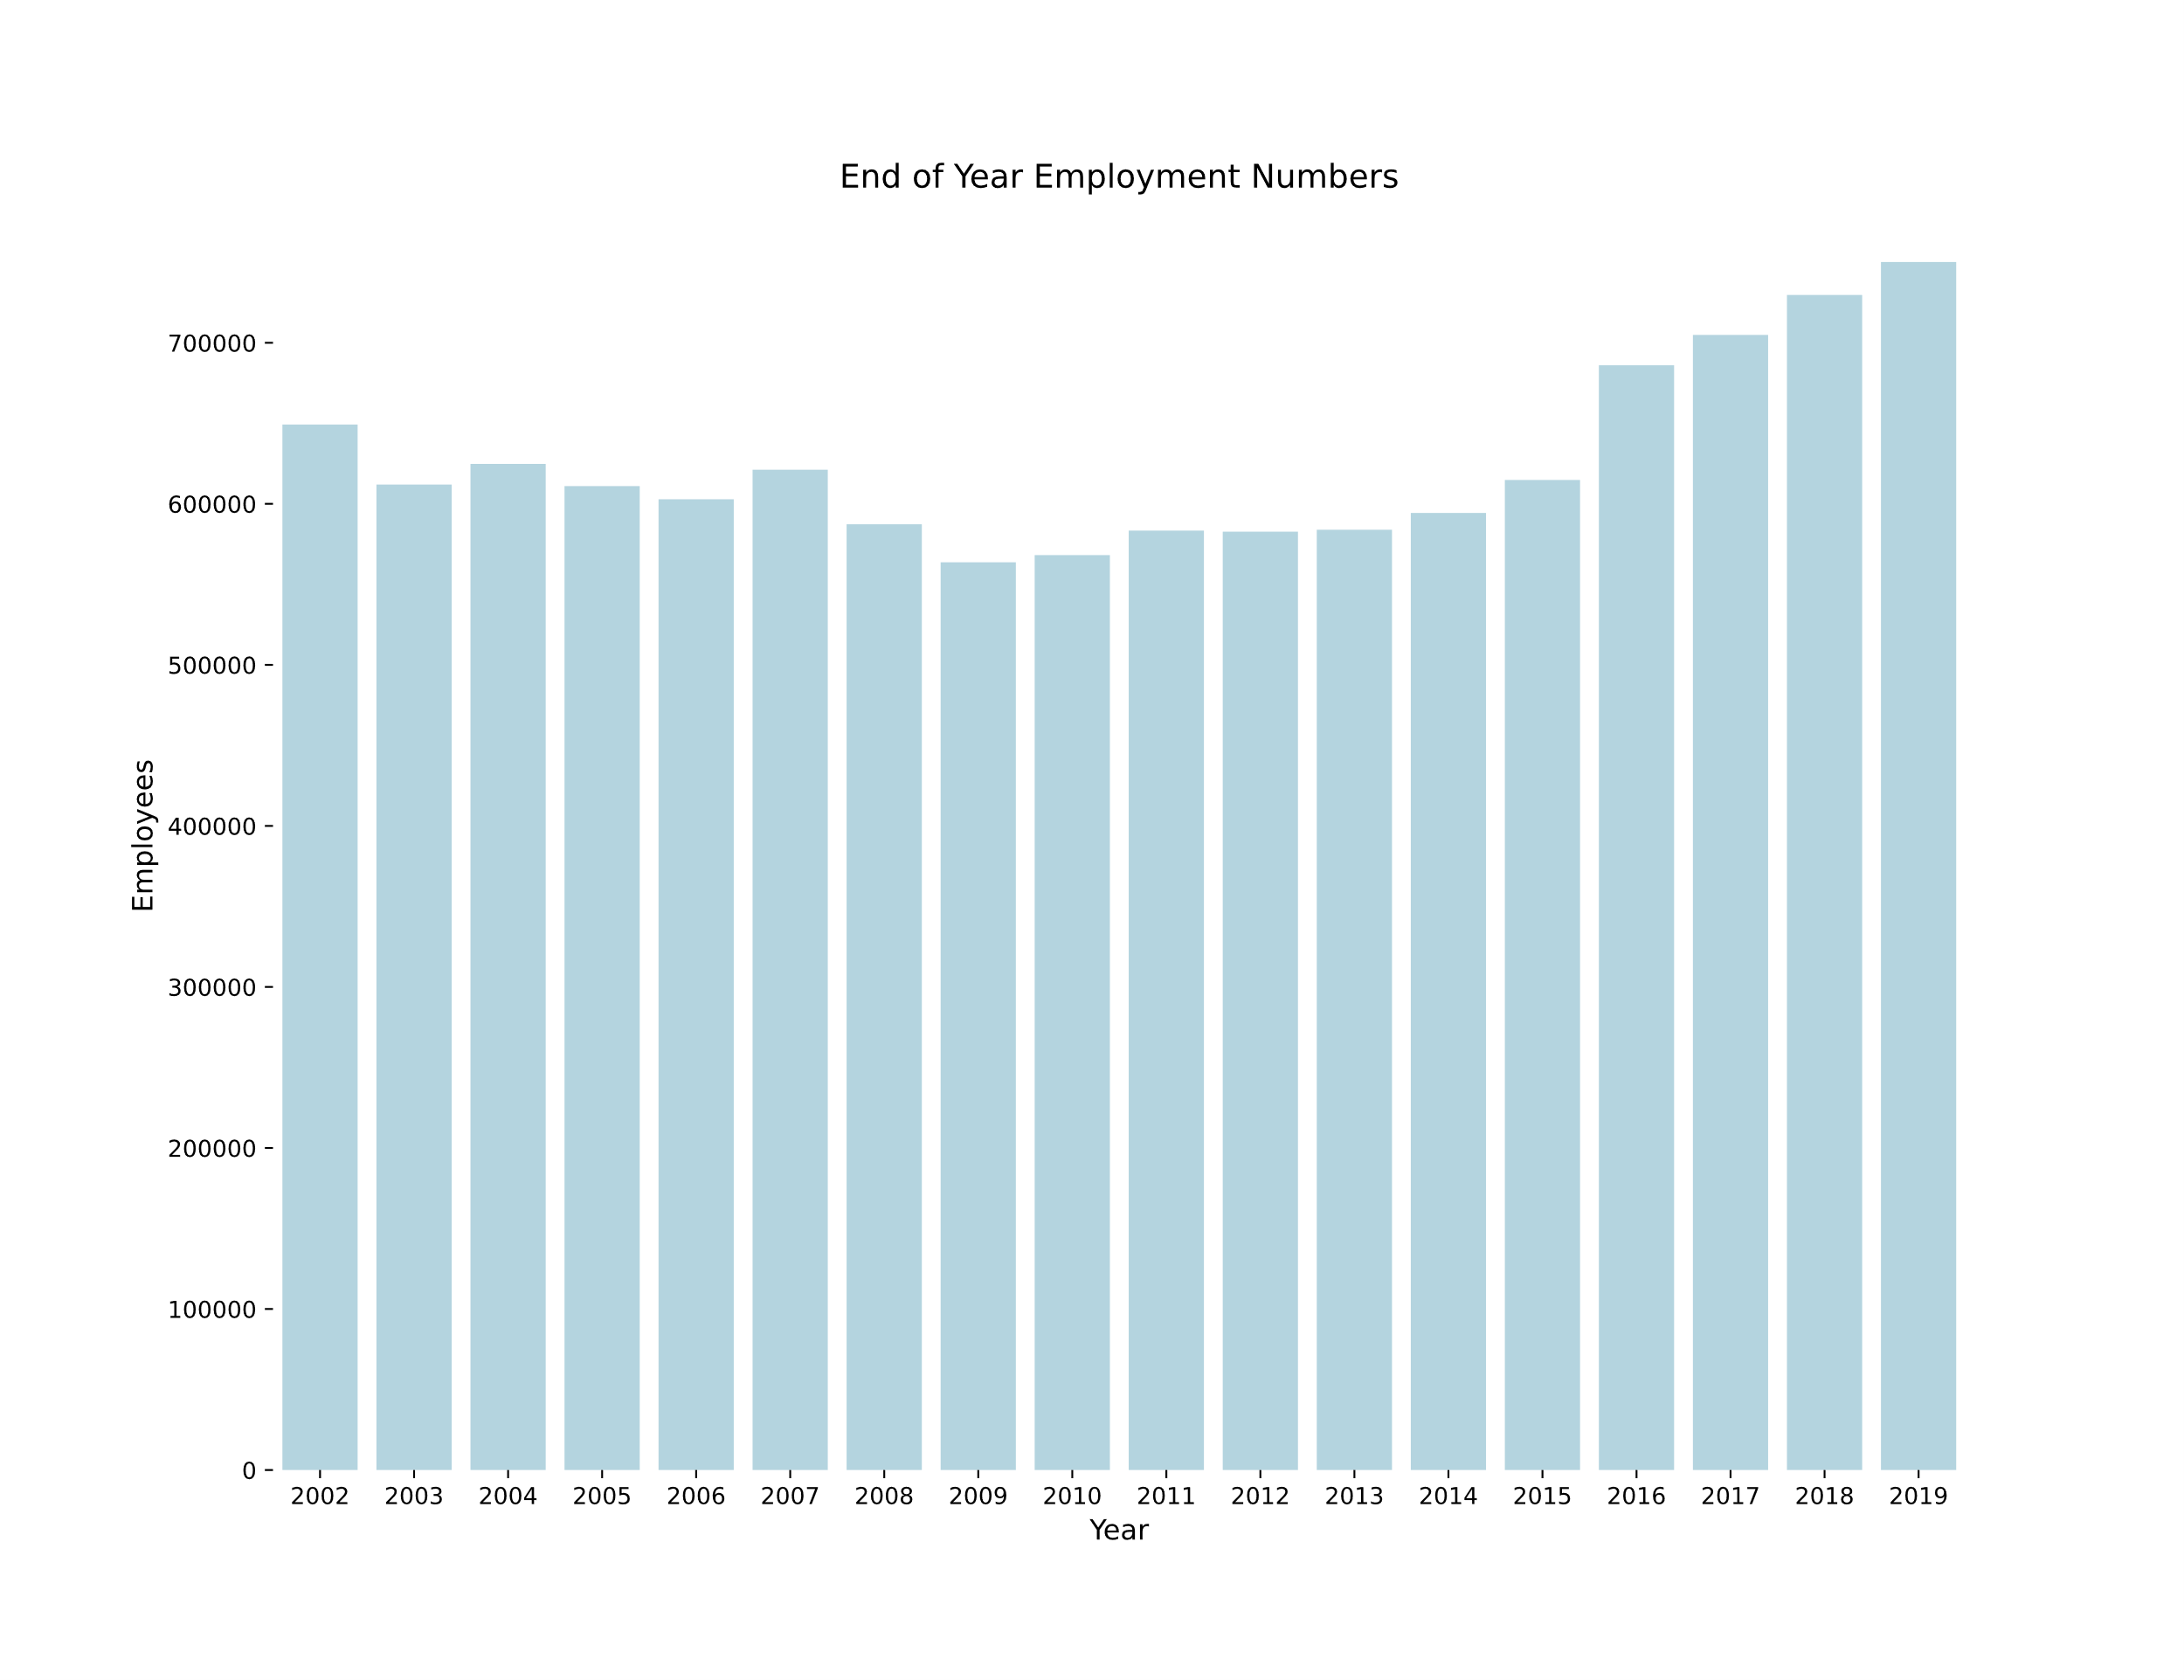
Airline Industry is Important
Our safety record is impeccable
Ridership is up, when there is not a global pandemic.
And maybe most importantly
We provide jobs to hundreds of thousands of people
Allow families to connect across countries
Contribute to the overall global economy!

